Slide 1
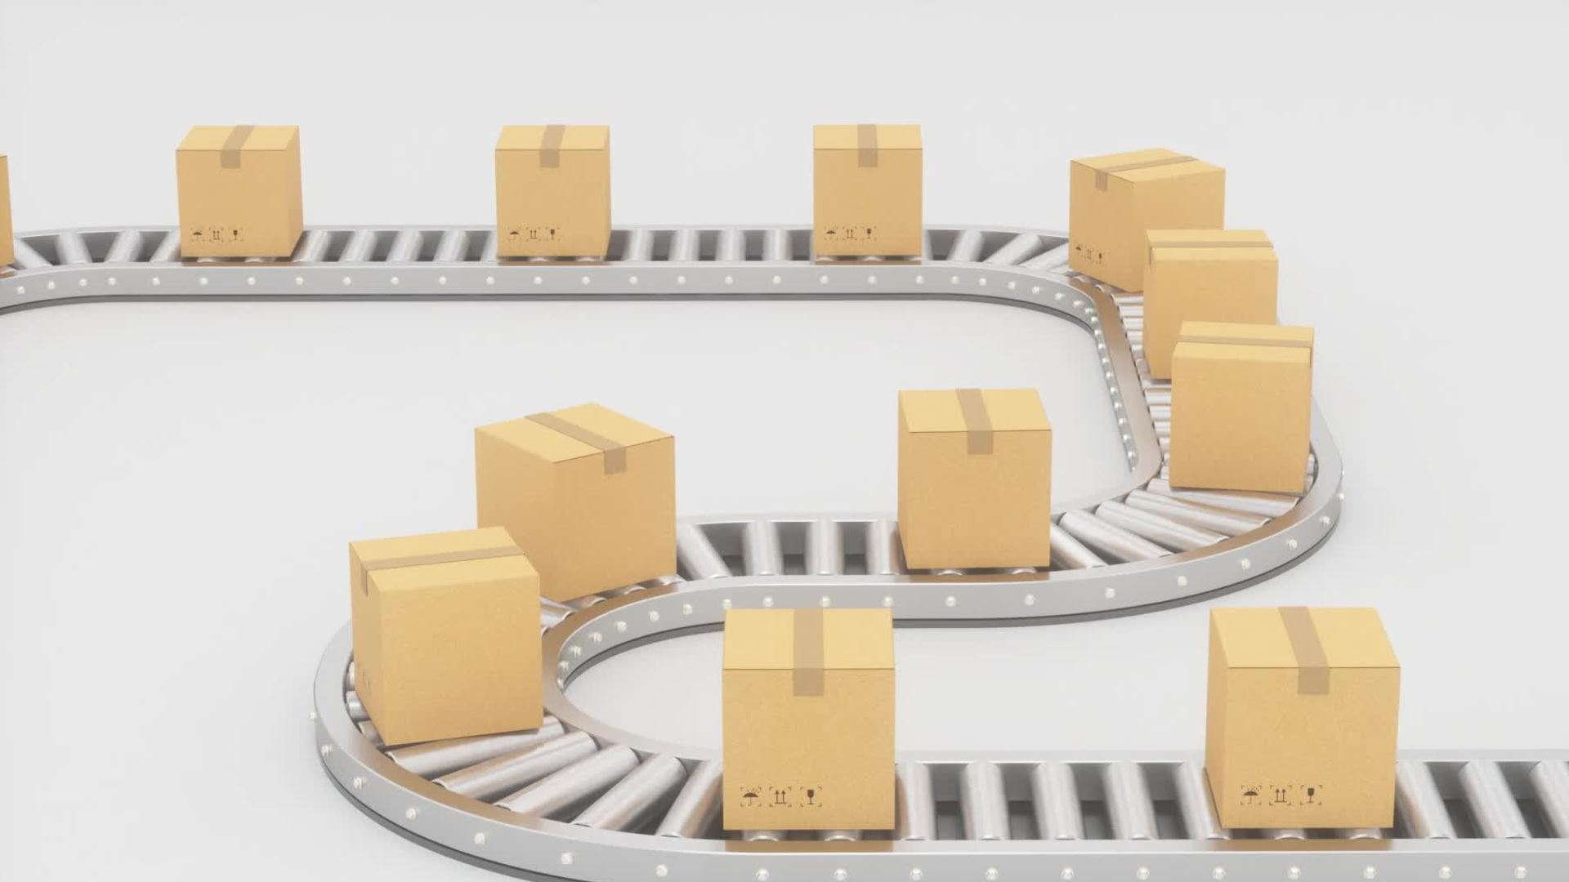
Transportation Management System Database Design
Zhi Zheng, Marckenrold Cadet, and David Carbajal

Slide 2
Purpose of the Transportation Management System Database
Develop a comprehensive system to manage transportation logistics.
Streamline operations for customers, orders, shipments, vehicles, drivers, routes, warehouses, and inventory.
Ensure seamless operations and accurate tracking.

Slide 3







Functional Requirements
CUSTOMER MANAGEMENT
ORDER MANAGEMENT
SHIPMENT TRACKING
VEHICLE AND DRIVER RECORDS
ROUTE AND STOP PLANNING
WAREHOUSE AND INVENTORY MANAGEMENT
EXPENSE RECORDING

Slide 4
Non-Functional Requirements
Scalability
Data Integrity and Security
Usability
Performance
Reliability
Compliance

Slide 5

Business Rule Part 1: Business Rules Overview
Customer to Orders: A customer can place zero to multiple orders, establishing an optional one-to-many relationship between customers and orders. Conversely, each order must be associated with a single customer, making this relationship mandatory.
Shipment and Expenses: A shipment can incur multiple expenses, establishing an optional one-to-many relationship between shipments and expenses. Conversely, each expense must be linked to a single shipment, making this relationship mandatory for the expense side.
Person Role Assignment: A person is a (Driver, Administrator, Dispatcher, or Customer), indicated by Role attribute in the Person table (Driver, Administrator, Dispatcher, Customer), enforcing a total completeness and disjoint constraint.

Slide 6

Business Rule Part 2: Shipment and Vehicle Management
Shipment to Stops: Each shipment can include multiple stops along its route, establishing a mandatory one-to-many relationship between shipments and stops. Conversely, each stop must be associated with a single shipment, making this relationship mandatory.
Vehicle to Shipments: A vehicle is capable of transporting multiple shipments at any given time, forming a mandatory one-to-many relationship between vehicles and shipments. Conversely, each shipment must be transported by a single vehicle, making this relationship mandatory.
Vehicle and Driver Assignment: Each driver can be assigned to zero to multiple vehicle, establishing a one-to-many relationship. Conversely, each vehicle must have at least one driver assigned (mandatory), but a driver might not always be assigned to a vehicle (optional).

Slide 7

Business Rule Part 3: Inventory and Route Management
Inventory and Warehouse: Inventory items are stored in warehouses, creating a mandatory one-to-many relationship between warehouses and inventory items. Conversely, each inventory item must be stored in a single warehouse, making this relationship mandatory.
Order to Shipments: Each order can result in a shipment, forming a optional one-to-many relationship between orders and shipments. Conversely, each shipment must be result from a order, making this relationship mandatory.
Routes and Stops: Each route can include multiple stops, forming a mandatory one-to-many relationship between routes and stops. Conversely, each stop must be part of a single route, making this relationship mandatory.

Slide 8
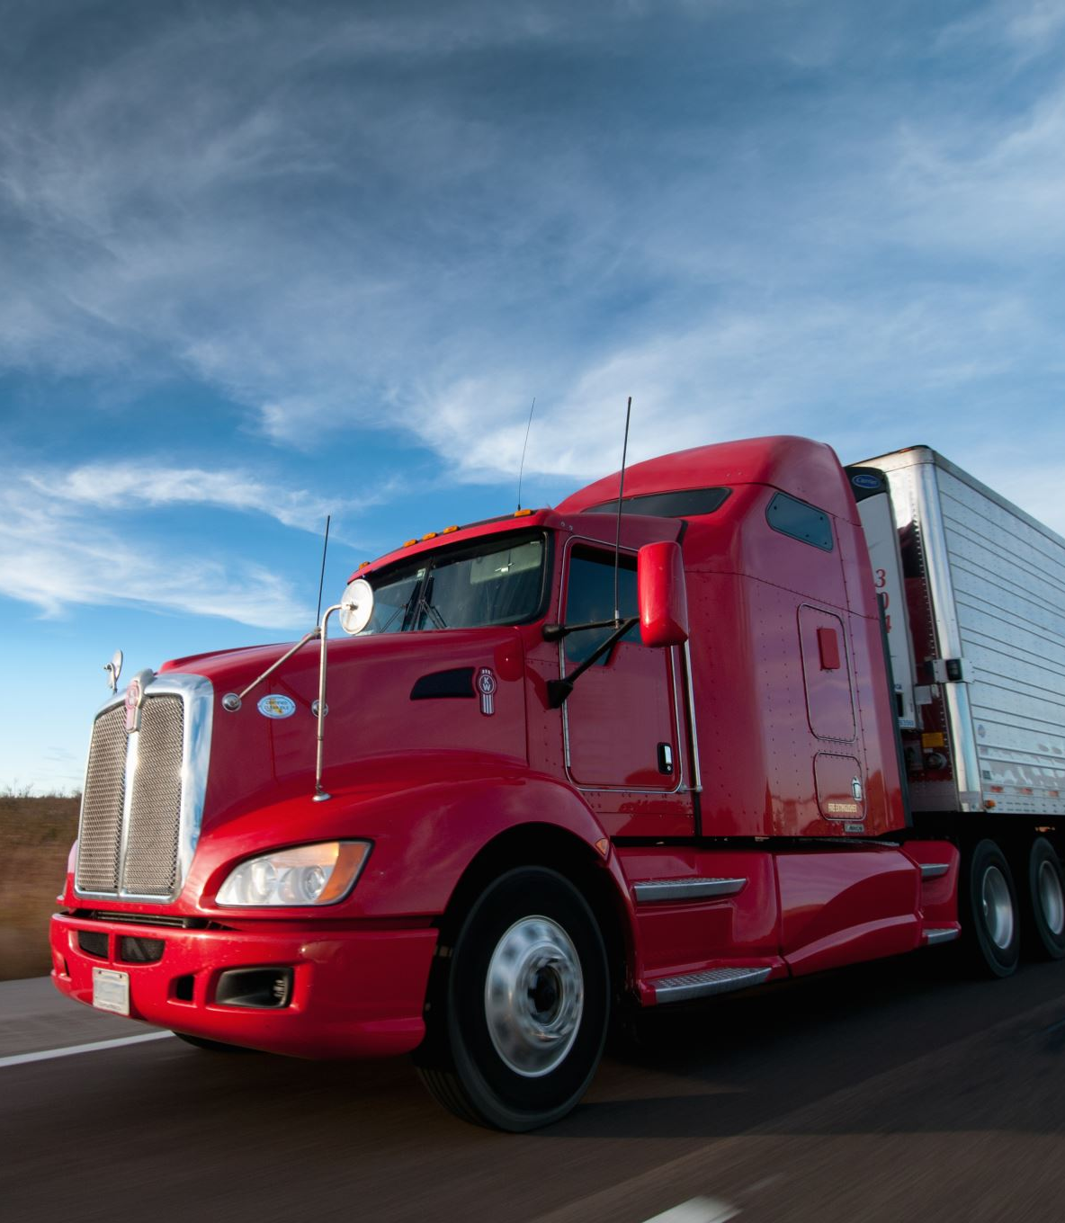
Assumptions
User and Role Management:
Each user has a unique UserID with specific roles (Customer, Driver, Administrator, Dispatcher) determining access and permissions.
User credentials (Username and Password) are securely stored and managed.
Data Integrity and Schema Design:
Primary keys and foreign key constraints ensure data integrity.
Database schema in Third Normal Form (3NF) to eliminate redundancy.
Tables for users, customers, warehouses, inventory, administrators, drivers, dispatchers, orders, shipments, stops, routes, and vehicles with initial data for testing.

Slide 9
Assumptions
Performance and Security:
Indexing on frequently queried columns for optimized data retrieval.
User authentication for secure access, with compliance to data protection regulations.
Scalability and Data Quality:
Accurate and consistent data entry with regular validation checks.
System designed to scale for future growth in users, orders, and vehicles, supporting real-time operations like tracking shipments and updating inventory.

Slide 10
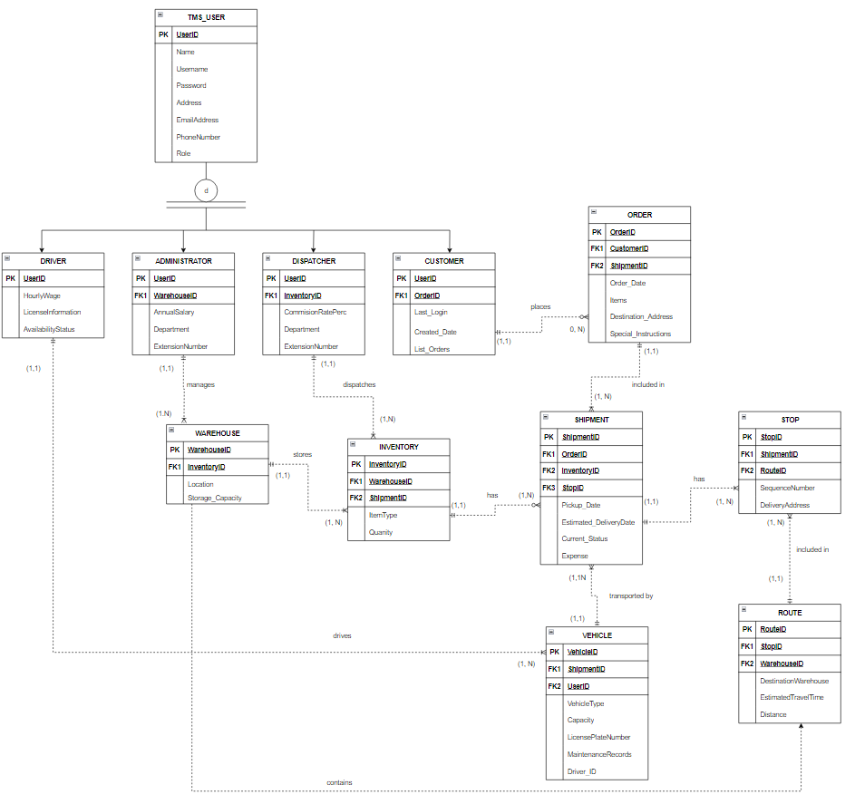
ERD OVERVIEW

Slide 11
Entities
Person
Driver
Administrator
Dispatcher
Customer
Order
Warehouse
Inventory
Shipment
Stop
Vehicle
Route

Slide 12
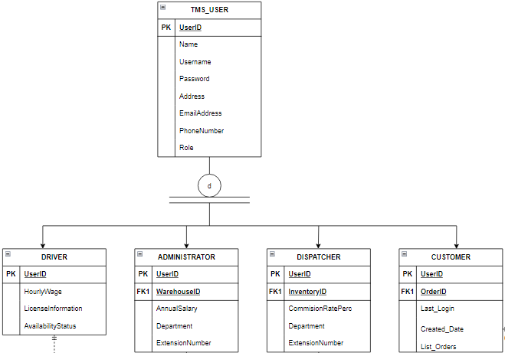
SPECIALIZATION HIERARCHY

Slide 13
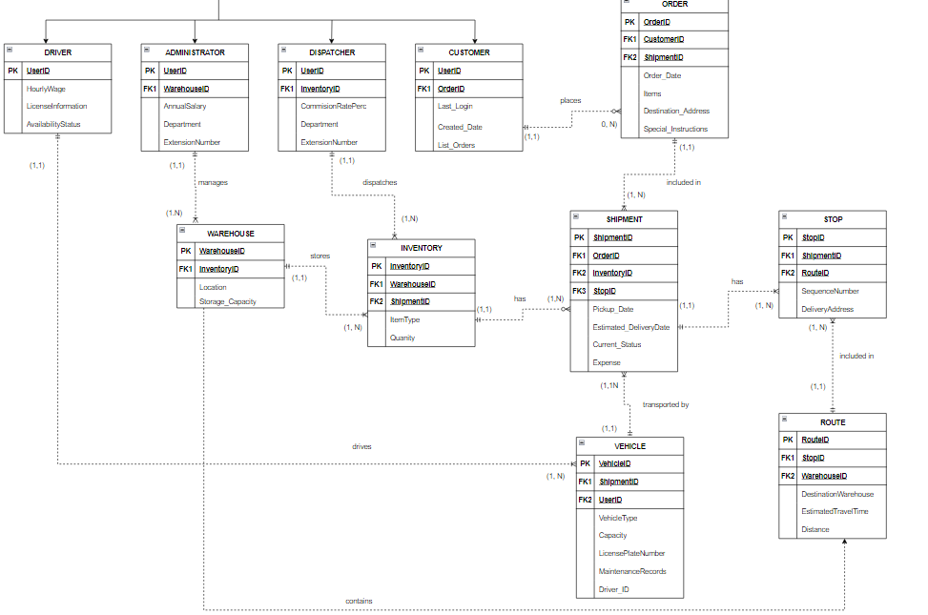

Slide 14
CARDINALITIES AND CONNECTIVITIES

Slide 15
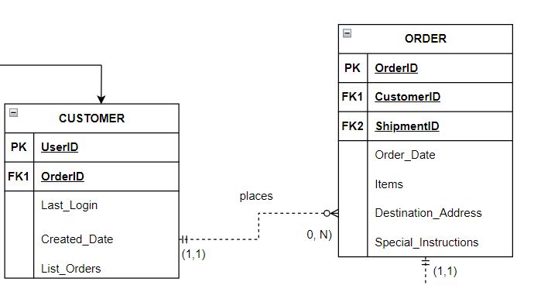
BETWEEN CUSTOMER AND ORDER
Cardinality: One and only customer may place no order or several orders
Connectivity: 1:M

Slide 16
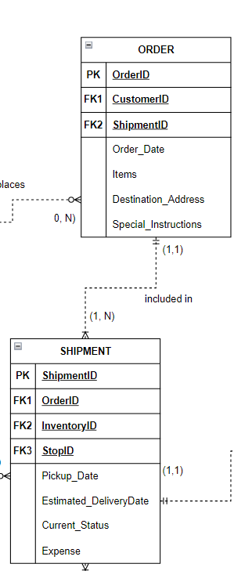
BETWEEN ORDER AND SHIPMENT
Cardinality: One and only order is included in one or many shipments
Connectivity: 1:M

Slide 17
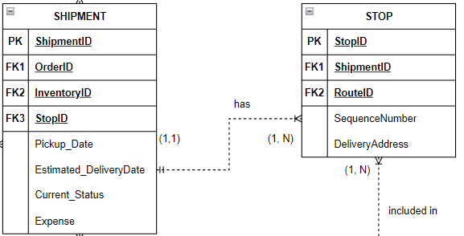
BETWEEN SHIPMENT AND STOP
Cardinality: One and only one shipment may have one or several stops
Connectivity: 1:M

Slide 18
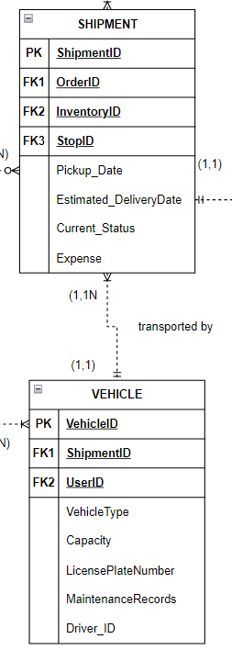
BETWEEN SHIPMENT AND VEHICLE
Cardinality: One or many shipments are transported by one and only one vehicle
Connectivity: 1:M

Slide 19
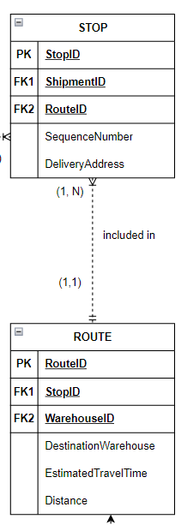
BETWEEN STOP AND ROUTE
Cardinality: One or many stops are included in one and only one route
Connectivity: 1:M

Slide 20
BETWEEN DRIVER AND VEHICLE
Cardinality: One and only one driver drives one or many vehicles.
Connectivity: 1:M

Slide 21
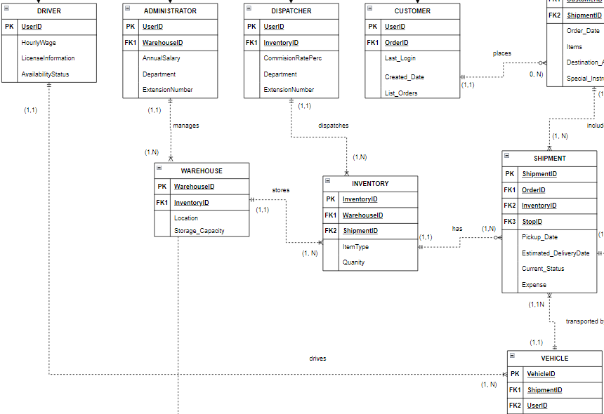

Slide 22
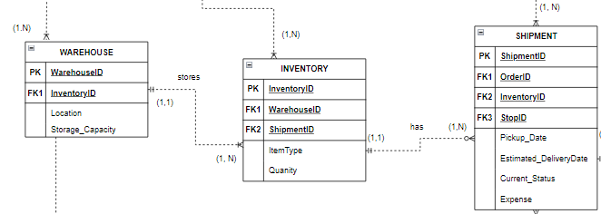
BETWEEN WAREHOUSE AND INVENTORY
Cardinality: One and only one warehouse stores one or many inventories
Connectivity: 1:M

Slide 23
BETWEEN INVENTORY AND SHIPMENT
Cardinality: One and only inventory has one or many shipments
Connectivity: 1:M

Slide 24
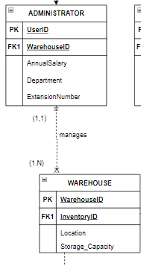
BETWEEN INVENTORY AND SHIPMENT
Cardinality: One and only one administrators manages one or many warehouses
Connectivity: 1:M

Slide 25
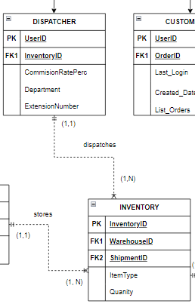
BETWEEN INVENTORY AND SHIPMENT
Cardinality: One and only one dispatcher dispatches one or several inventories.
Connectivity: 1:M

Slide 26

BETWEEN WAREHOUSE AND ROUTE
One and only one warehouse contains one or many routes

Slide 27
NORMALIZATION
1NF: All tables have a primary key and each attribute has atomic values.
01
2NF: All the tables are in 1NF and there are no partial dependencies because there is only one primary key determining the rest of the attributes in each table.
02
3NF: All the tables are in 2NF and there are no transitive dependencies since all attributes are determined by the primary keys.
03

Slide 28

IMPLEMENTATION

Slide 29
DATABASE CREATION
The database was implemented in ElephantSQL
-All tables, columns, data types, primary keys, and foreign keys are defined
The TMS_USERS, CUSTOMER, DRIVER, ADMINISTRATOR, DISPATCHER, WAREHOUSE, INVENTORY, ORDER, SHIPMENT, STOP, ROUTE, and VEHICLE tables are created with appropriate constraints to ensure data integrity.

Slide 30

DATABASE INSERTION
After establishing the schema, test data is inserted (populated) into the tables.

Slide 31

SETTING UP RELATIONSHIPS
Establishing relationships between tables is critical to maintain referential integrity.
Ensuring data consistency across the database, and operations such as updates and deletions maintain data integrity.

Slide 32

USER INTERFACE INTEGRATION
The Shiny app is integrated with the ElephantSQL database to provide a seamless user experience.
This involves setting up the database connection within the Shiny app, allowing the app to perform CRUD (Create, Read, Update, Delete) operations on the database.
-The Shiny app's UI components are designed to interact with the database, enabling users to log in, view data, and generate reports.

Slide 33

DATA SECURITY
Implementing data security measures is crucial:
-Setting up user authentication to restrict access to the database

Slide 34
PERFORMANCE OPTIMIZATION
Performance optimization ensures that the database and Shiny app run efficiently.
-Indexing is applied to frequently queried columns to speed up data retrieval(On columns like Name, Username, EmailAddress in TMS_USERS, for example)

Slide 35
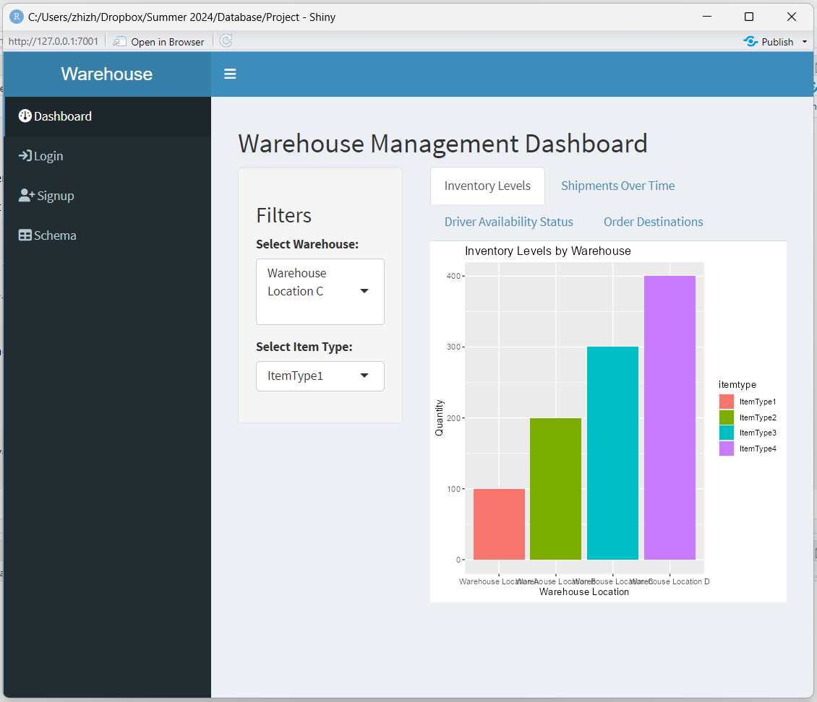
REPORTING & ANALYTICS
The system includes a reporting module capable of generating accurate and timely reports based on the available data.
-Data visualizations are used to present key performance indicators and trends in an easy-to-understand format.

Slide 36

CONCLUSION
Implementing the Transportation Management System (TMS) project successfully addressed the challenges of data integrity, user authentication, and seamless integration with a Shiny application
The database schema was meticulously designed to enforce referential integrity through primary and foreign key constraints, ensuring consistent and accurate data management.

Slide 37
CONCLUSION
The integration of the PostgreSQL database with the Shiny app provided a user-friendly interface, allowing for effective CRUD operations and real-time data interaction.
In conclusion, the project demonstrated the robustness and scalability of the TMS, providing a solid foundation for optimizing transportation logistics through advanced database design and user-friendly application interfaces.

Slide 38

FUTURE WORK
Future work will focus on enhancing data security by implementing encryption for sensitive information both at rest and in transit
Scalability improvements will involve optimizing the database and application architecture to support both horizontal and vertical scaling.
User experience enhancements will be a continuous effort involving ongoing improvements to the Shiny app interface based on user feedback which would enhance usability and functionality.

Slide 39

Questions?

